Slide 1
Dot Net Core

Slide 2
Introduction to .Net core
.NET Core is an open-source, cross-platform, modular platform that enables you to build and deploy applications that are targeted at multiple operating systems.

Slide 3
Characteristics of .NET Core
Cross-platform support : It can work on multiple platforms, such as Windows, Mac, and Linux.
Flexible deployment: You can deploy a .NET Core application side by side with your application seamlessly. It is a general-purpose development platform that consists of several components. These include the managed compilers, the runtime, and the base class libraries. It also includes many application models, such as the ASP.NET Core.
Modular: .NET Core is composed of a set of modular components. This enables you to take advantage of the package you want to use rather than including the entire .NET Core framework. This boosts performance as you end up creating applications that contain just what you need.
Open-source: .NET Core is open source using MIT and Apache 2 licenses and is available in GitHub.

Slide 4
NET Core Stack: The Architectural Components
A .NET runtime : This is used to provide type safety, garbage collection mechanism, native interop services, loading of assemblies, etc.
A collection of Framework Libraries: These provide the primitive data types, the utilities, etc.
A collection of SDK tools and compilers: These provide developer experience when working with the .NET Core SDK.

Slide 5
Advantage of .Net Core
.NET Core is Cross-Platform
.NET Core is Open Source
Mature Framework and Widely Used Programming Languages
The .NET Core Supports a Wide Range of Application Types
Increased Security with .NET Core
.NET Core Enables Top App Performance
.NET Core Enables Flexibility
.NET Core is Cost Effective
.NET Core has a Large Community

Slide 6
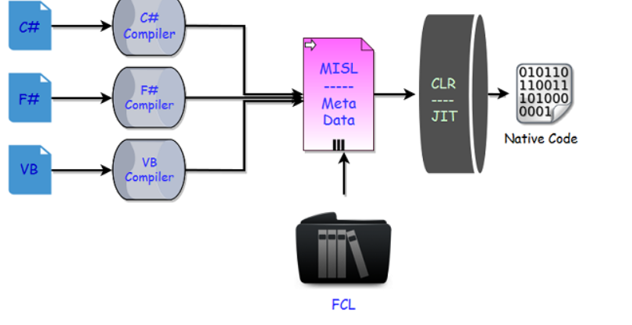
Code Execution
Choosing a compiler
Compiling your code to MSIL
Compiling MSIL to native code
Running code

Slide 7
Middleware
Middleware are software components that are assembled into an application pipeline to handle requests and responses.
Each component chooses whether to pass the request on to the next component in the pipeline, and can perform certain actions before and after the next component is invoked in the pipeline.
Request delegates are used to build the request pipeline. The request delegates handle each HTTP request.
Each piece of middleware in ASP.NET Core is an object, and each piece has a very specific, focused, and limited role.
Ultimately, we need many pieces of middleware for an application to behave appropriately

Slide 8
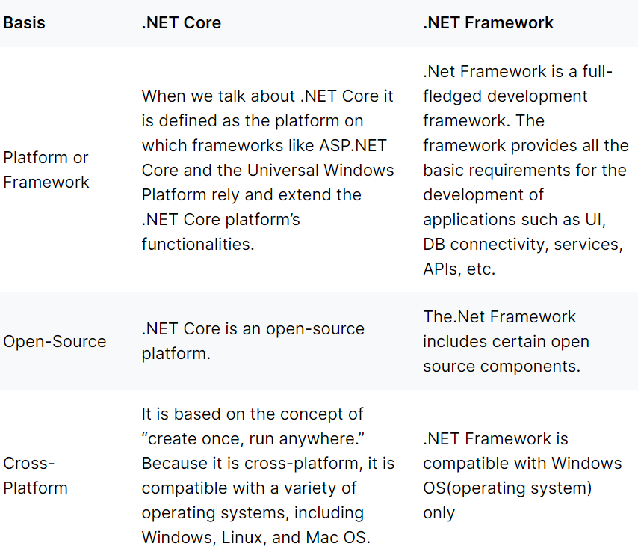
DIFFERENCE

Slide 9
